Slide 1
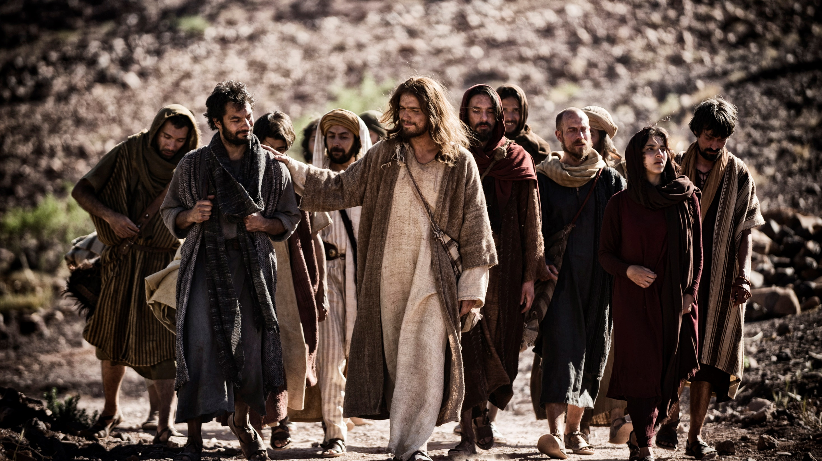
Forming intentional [committed] disciples
2nd Threshold: CURIOSITY

Slide 2
2nd Threshold: Curiosity Once you have established a bridge of trust, your role is to help your friend move towards curiosity. Curiosity can play out in varied ways. - some people are curios instinctively about the peace of their Catholic partner - some can be mysteriously moved by the rosary found among his grandmother’s things, p. 141

Slide 3
All these are works of the Holy Spirit So watch, listen, and respect what is happening with someone who already has a basic trust!

Slide 4
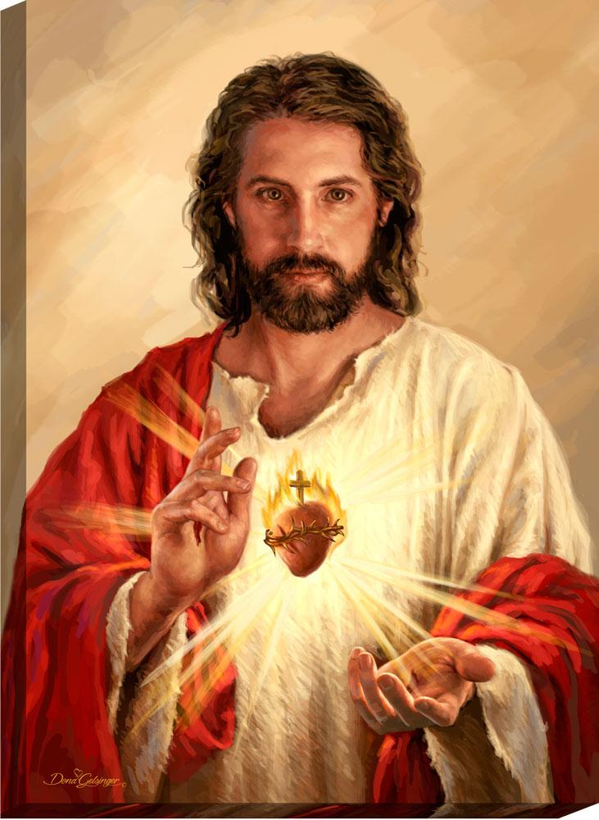
Curiosity about what? Jesus To arouse curiosity about Jesus we need to talk about Jesus; about Jesus with whom you have a personal relationship. p.141

Slide 5
Whenever we treat Jesus as a “topic’’ instead of as “the whole spiritual good of the Church” or as a ‘’belief” among other beliefs instead of as Lord, Head, Bridegroom, and Elder Brother we profoundly’ distort the faith and communicate an imperfect understanding of what it means to be Catholic.

Slide 6
The purpose of RCIA is to help people fall in love with Jesus, and to fall in love with the Church. ‘The threshold of curiosity is a perfect time to explore that a personal God exists and that you can have a personal relationship with Him.’ /Sherry Weddell, p.144/
This Photo by Unknown Author is licensed under CC BY-SA

Slide 7
‘Those who don’t believe in a personal God and the possibility of a relationship with God will never be able to move beyond the threshold of curiosity.’ /Sherry Weddell, p.144/

Slide 8
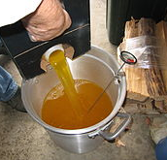
‘At this stage individuals often need a very safe, non-threatening way to express their curiosity without overreaction or pressure from us. It is very important that we tread lightly here. You can easily quench inquiries by drowning a teaspoon full of curiosity with a gallon of answers.’

Slide 9
‘Match your response to your friend’s level of curiosity, and then wait for him/her to become curious again.’ /Sherry Weddell, p.145/

Slide 10
The stages of curiosity - Awareness: - of more possibilities in life - Engagement: curious person taking steps to pursue curiosity - Exchange: experience of intense curiosity

Slide 11
One of the best ways to rouse curiosity is to ask questions, not answer them. Jesus was master of asking questions. He didn’t so much run Q & A sessions. In the NT He asked 183 questions and gave 3 answers.

Slide 12
‘What do you want me to do for you?’ (Mk 10:51) Woman where are they? Has no one condemned you? (Jn 8:10) But who do you say that I am? (Mt 16: 15) Who touched my garments (Mk 5:30)

Slide 13
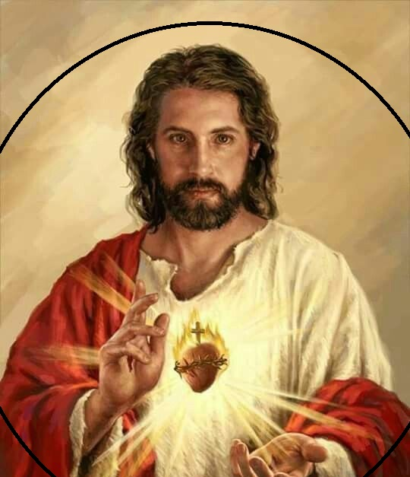
The point of this approach is to allow the natural curiosity of the human person to draw him or her to an encounter with Jesus himself.

Slide 14
‘In the Gospel of John we find Jesus constantly making statements that pull His hearers into wondering what He could mean: “Destroy this temple and in three days I will raise it up” (John 2:19) “Unless one is born of water and the Spirit .. He cannot enter the kingdom of God” (John 3:5)

Slide 15
“Unless you eat the flesh of the Son of man and drink his blood, You have no life in You” (John 6:53); “Before Abraham was, I am” (Jn 8:58) All of these sayings were to provoke curiosity, as a first reaction, even when the curiosity turned into bewilderment or even hostility against him.

Slide 16
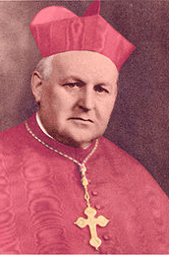
When you live a life that is inexplicable, apart from the grace and power of God and the Gospel, you will often spark curiosity, particularly in people who were previously hostile to faith or believers. ‘To be a witness…means to live in such a way that one’s life would not make sense if God did not exist.’ /Emmnuel Cardinal Suhard/, p.148

Slide 17
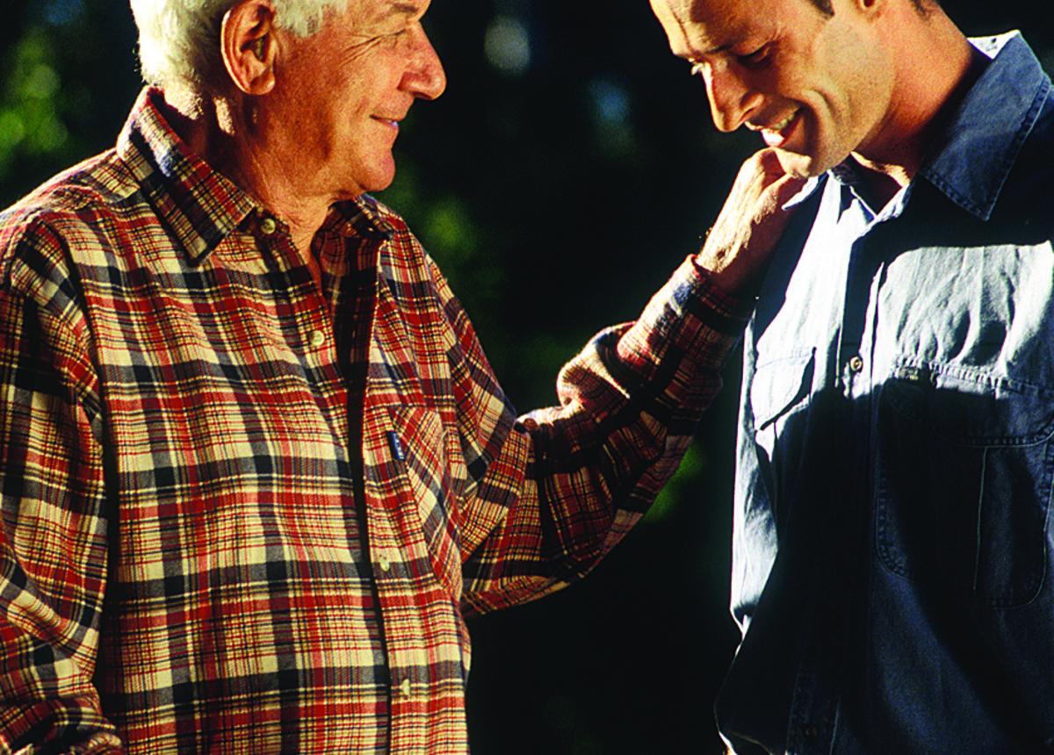
One powerful way to rouse curiosity is to tell stories. Jesus told a lot of stories and parables. Telling stories from the NT or your own or someone else’s experiences of healing and forgiveness can be very thought-provoking.

Slide 18
CURIOSITY Is NOT SEEKING Curiosity involves trust but not openness to change. And it is certainly not the intense spiritual quest of true seeking.

Slide 19
What many participants find hard to grasp at first is the difference between passively going with the flow and a truly active spiritual quest.
This Photo by Unknown Author is licensed under CC BY-SA-NC

Slide 20
LIVING CURIOUSLY - means more than being nice. - it means that your life is inexplicable (you rejoice when people would normally be sad, or you have peace when people are upset, you have faith in the midst of storms of life) - it requires that you think and act in Kingdom-oriented and countercultural way in your daily life.

Slide 21
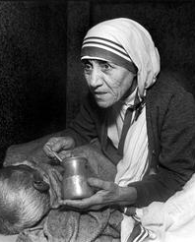
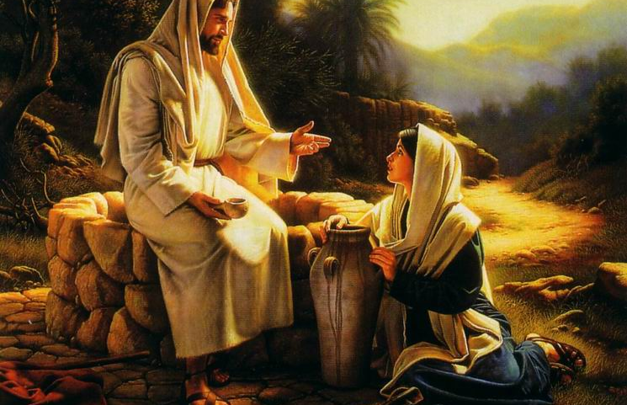
- Speaking the truth in love - Honouring others with our words - living in healthy relationships - caring for the poor - sharing possessions freely - praying for healing - simple family prayers together All these empowered by a personal relationship with Christ in the Eucharist CAN ROUSE CURIOSITY

Slide 22
To rouse curiosity -Helpful parish based programmes: Landings http://landingsintl.org/ Catholics Returning Home www.catholicsreturninghome.org www.CatholicsComeHome.org

Slide 23
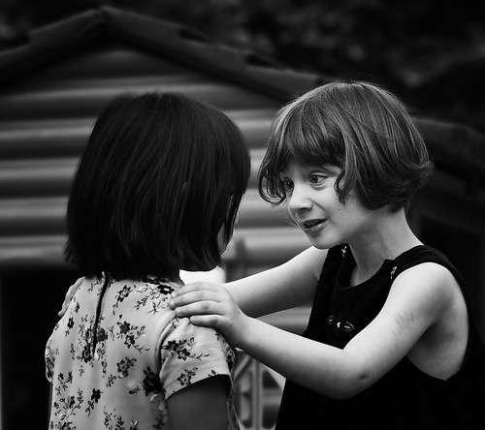
Unless we address what drew people away from the Church and God,
chances are very low that our returnees will stay.

